Slide 1




Introduction to Molecular Biology
Phuc Loi Luu, PhD
Email: Luu.p.loi@googlemail.com
Zalo: 0901802182
Jan 25 2025

Slide 2
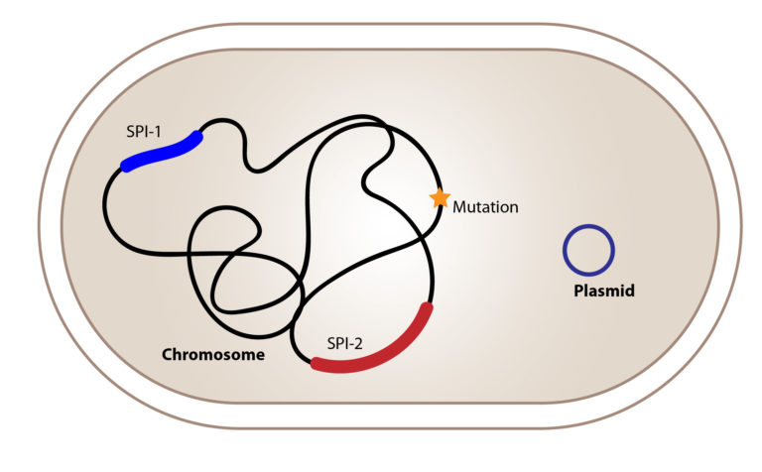
Prokaryotes from Genome to Proteins

Slide 3
Content
Class member introduction
Curriculum of Introduction to Molecular Biology
Projects and important dates
Evalutation for the course
How Introduction to Molecular Biology lecture work?

Slide 4

Class member introduction
Bạn phẻ không?
Phẻ! Cảm ơn bạn. Còn bạn?

Slide 5
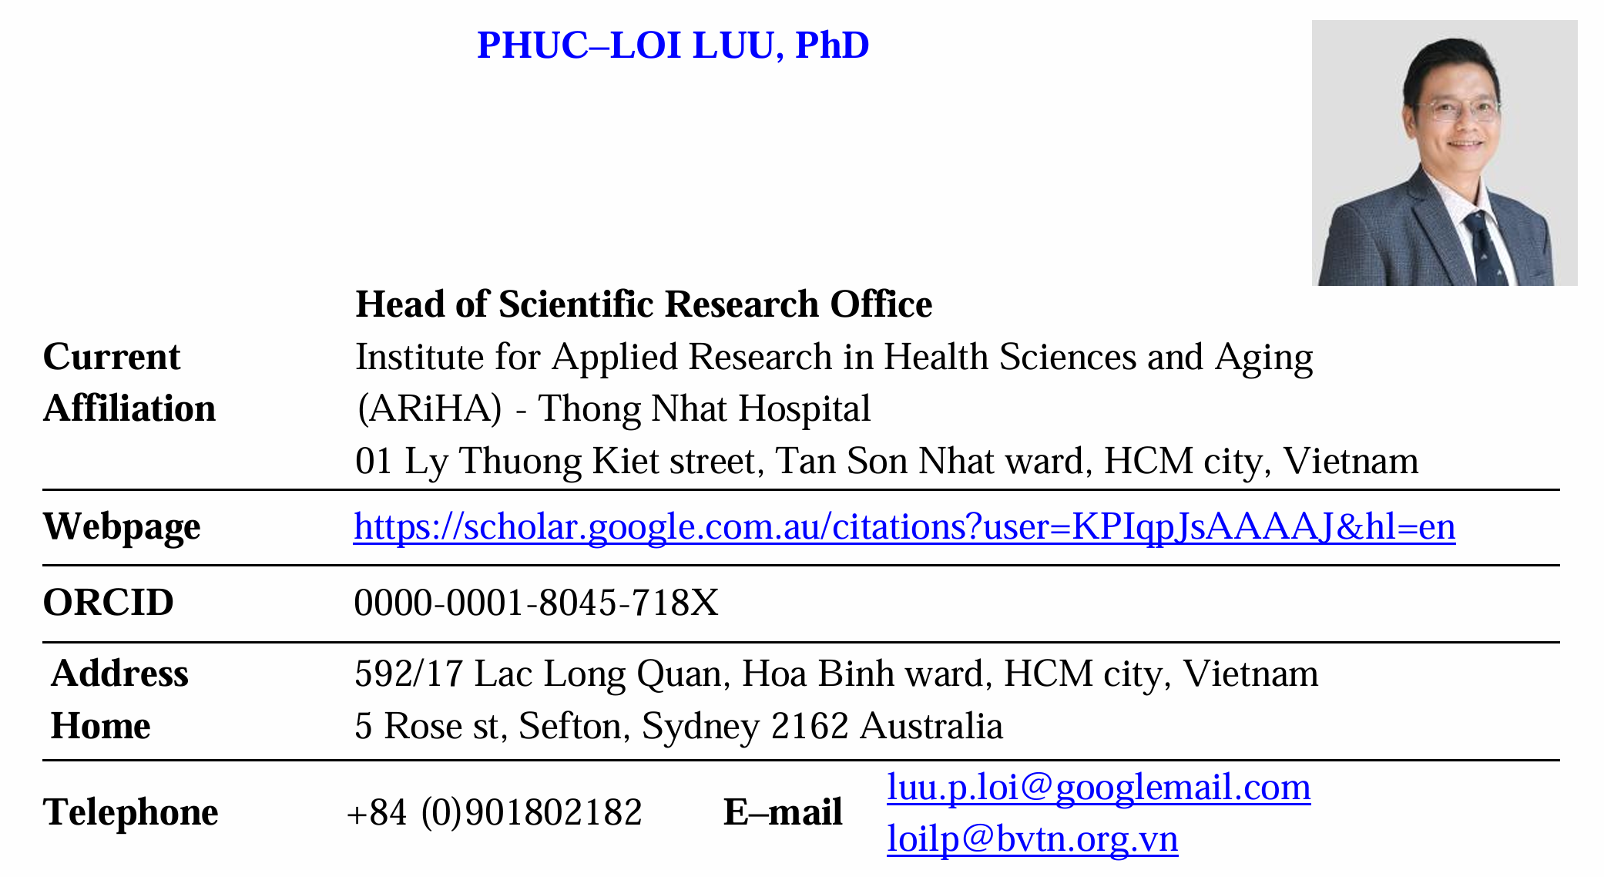

Slide 6
Education and Research Interest

Slide 7
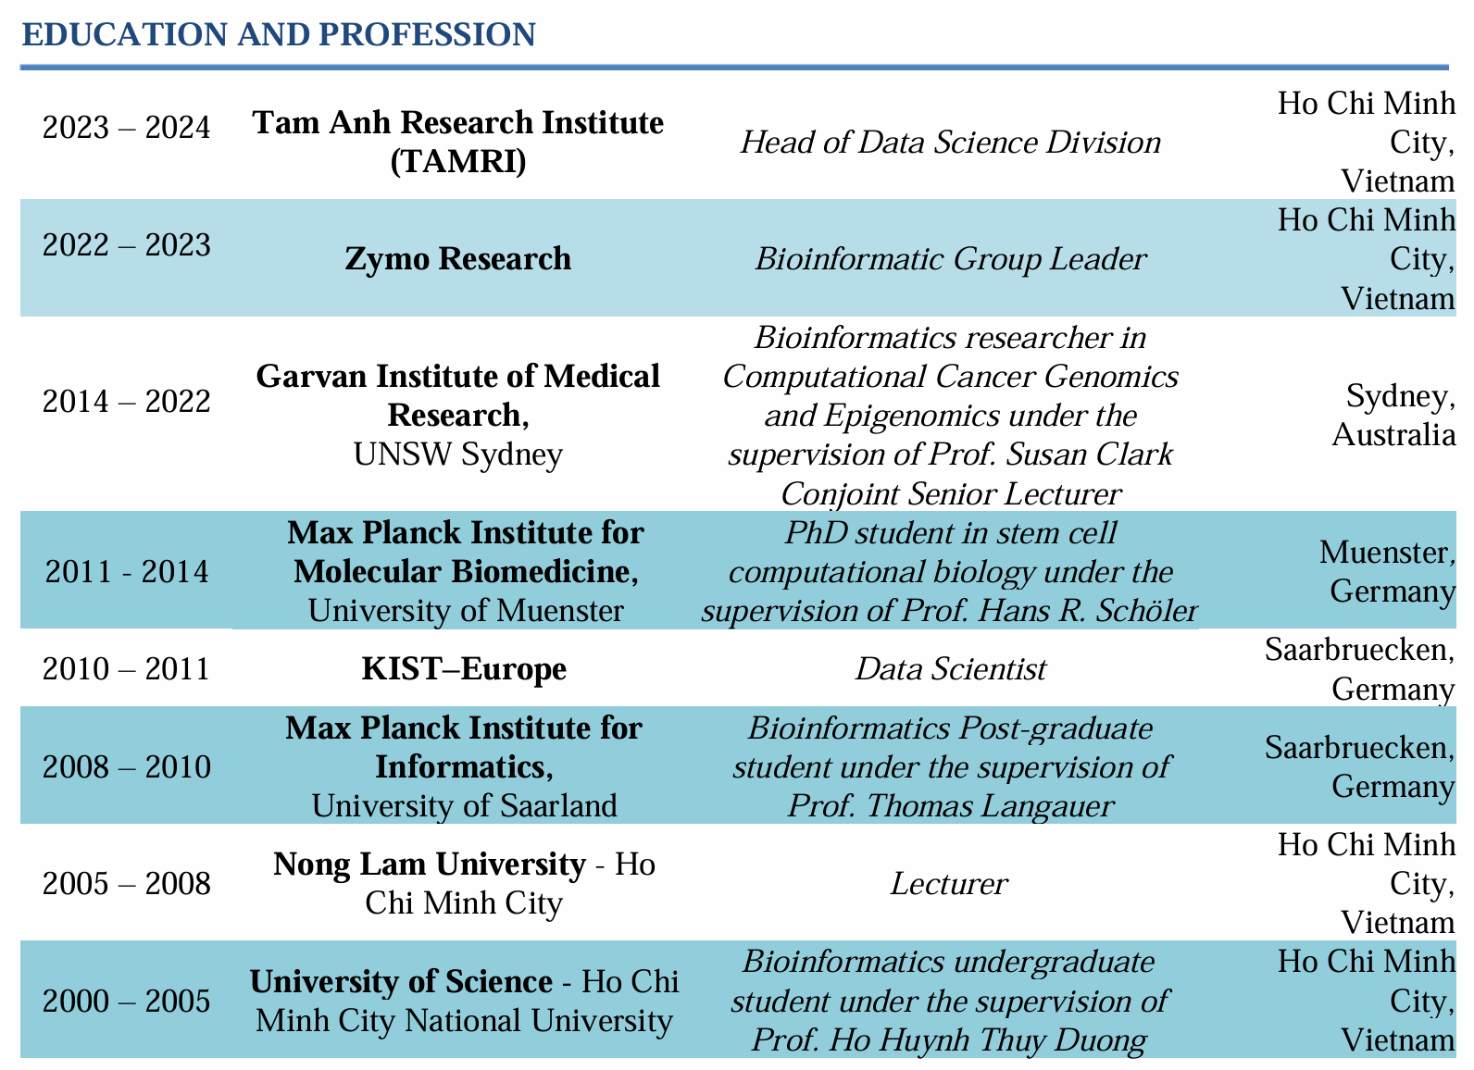
EDUCATION AND PROFESSION

Slide 8
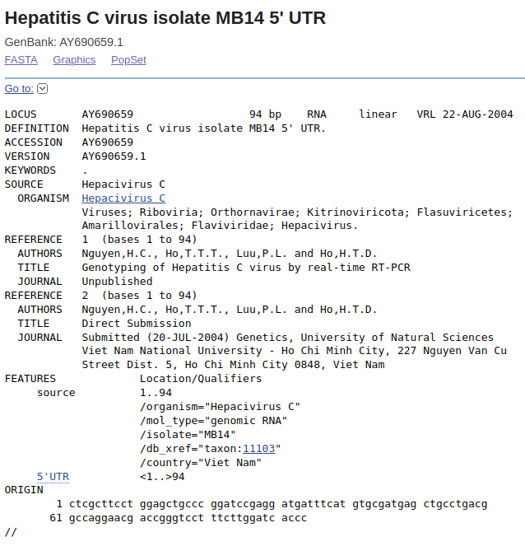
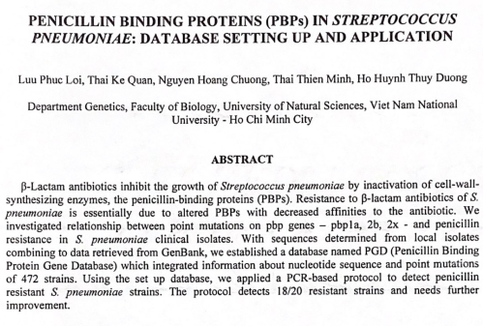
Undergraduate at University of Science - Ho Chi Minh City National University (2000 – 2005)
Major: Bioinformatics
Research Topics:
Genotyping HCV, HBV, HPV
Anti-biotics resistance in bacteria
The American journal of tropical medicine and hygiene 73(6):55-55 (2005).

Slide 9

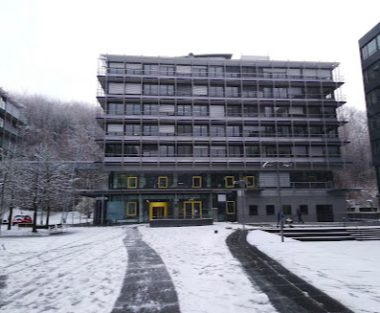

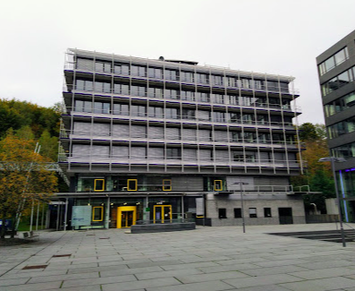
Master degree in Bioinformatics at Max Planck Institute for Informatics
University of Saarland in Germany (2007 - 2010)

Slide 10
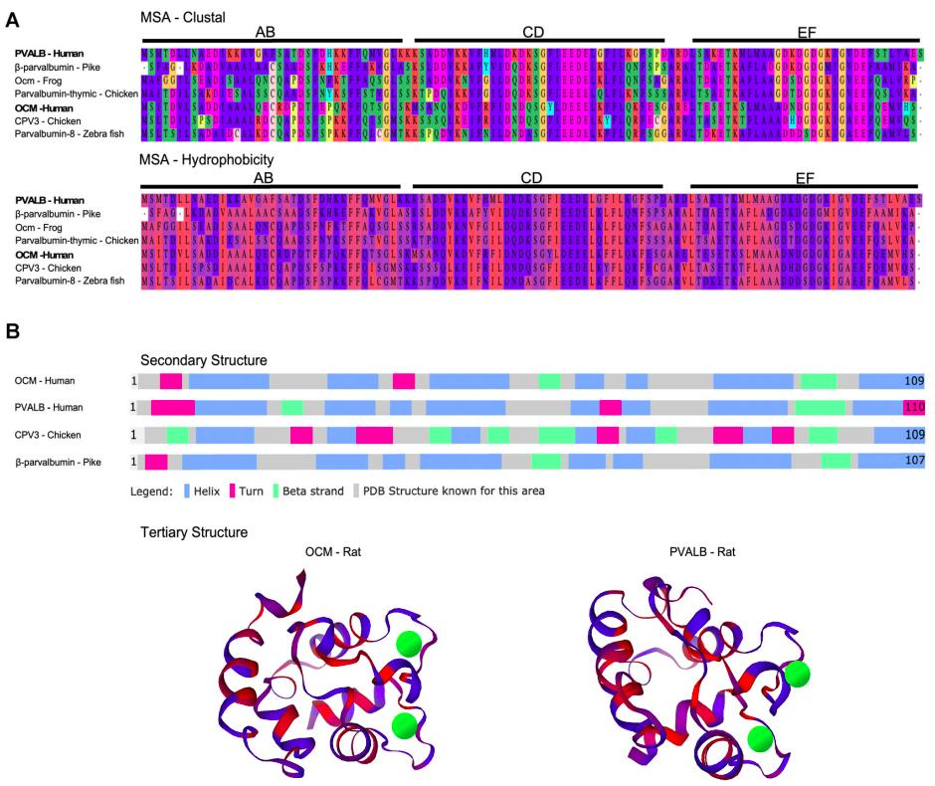

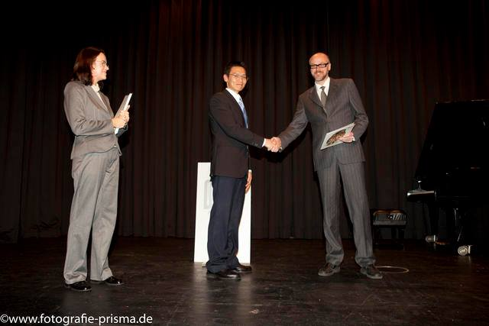
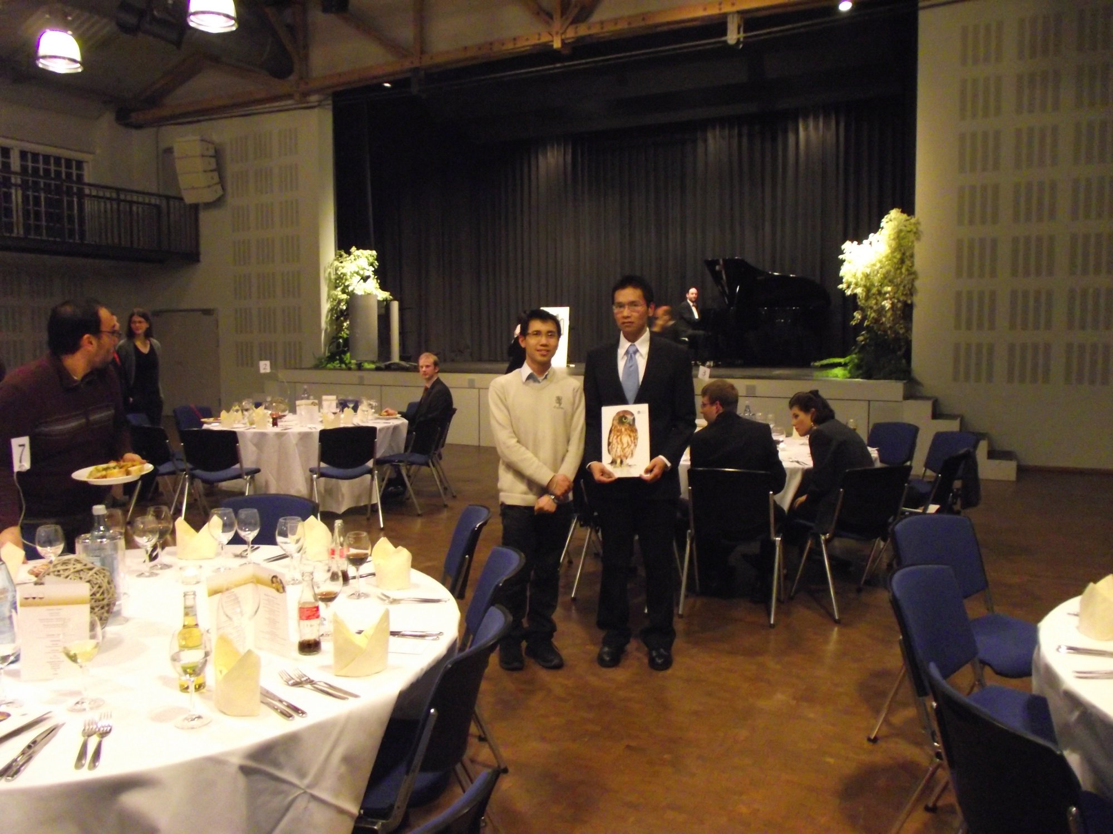
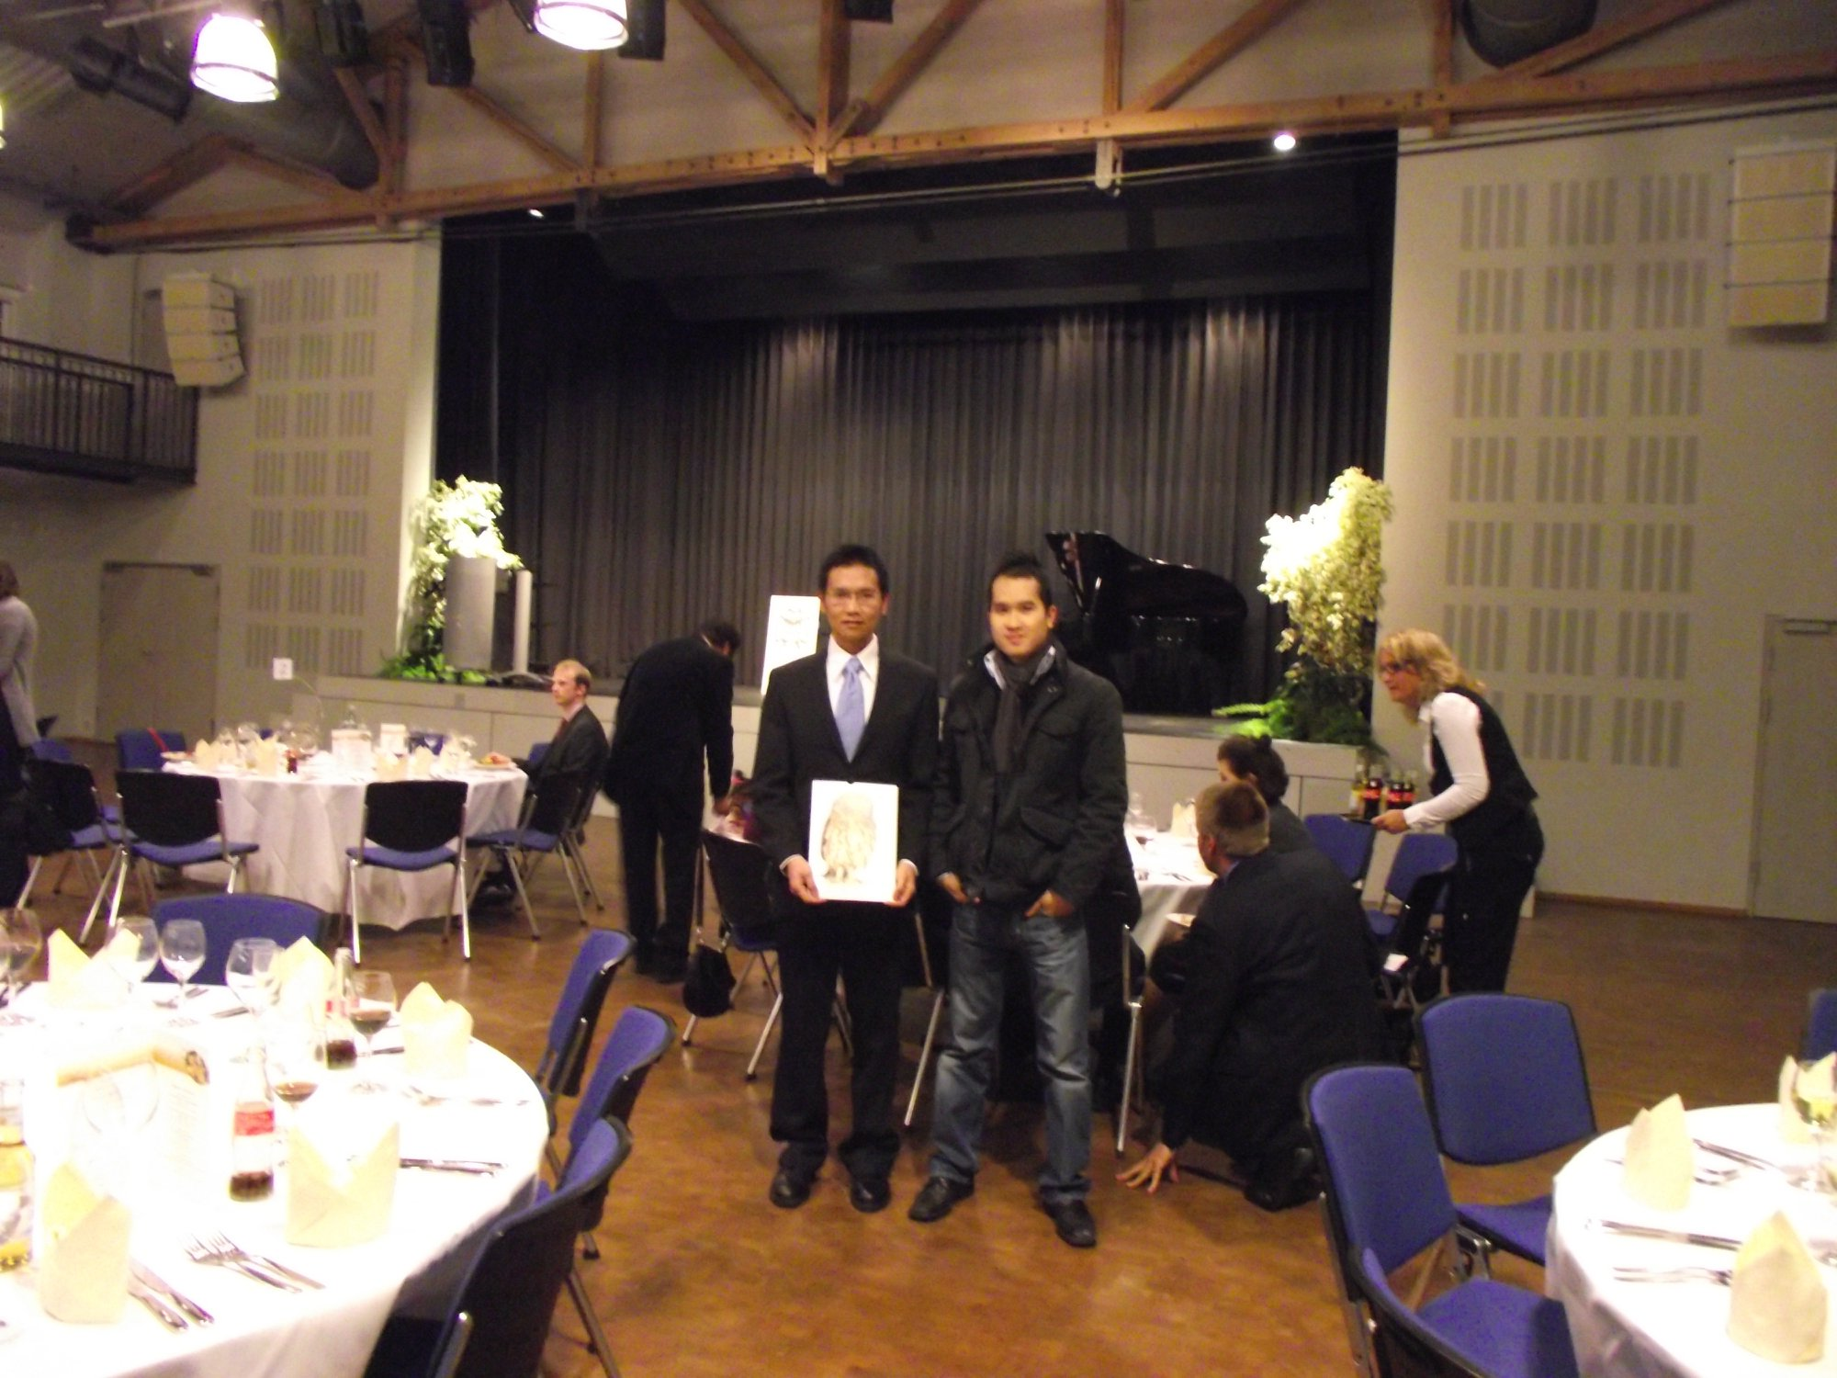
Identifying functional discriminative motifs in protein families
Protein structures and functions
Bigdata mining and Machine Learning

Slide 11
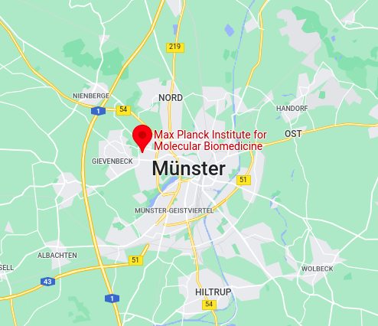


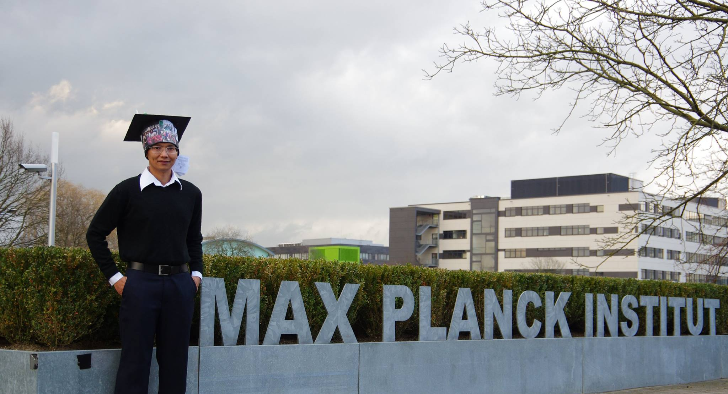
PhD at Max Planck Institute for Molecular Biomedicine and University of Muenster in Germany (2011 - 2014)

Slide 12
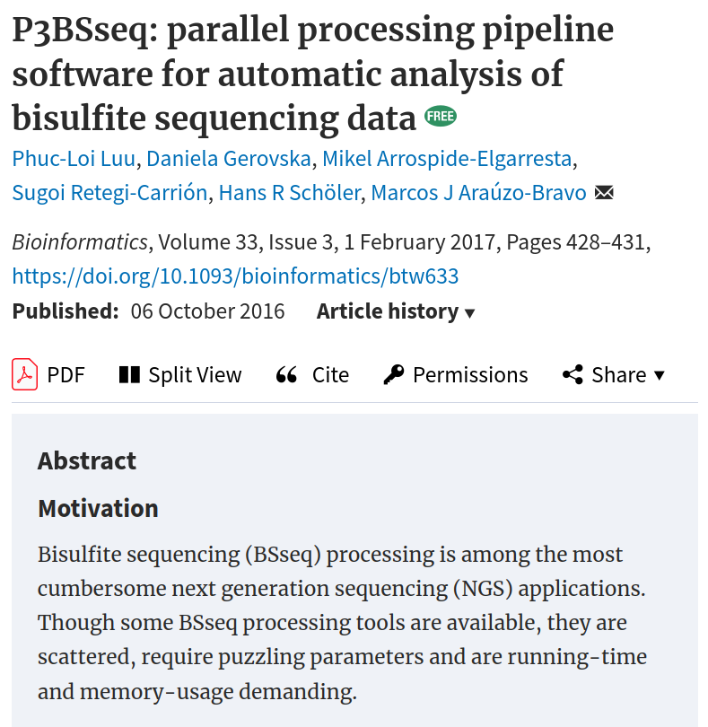
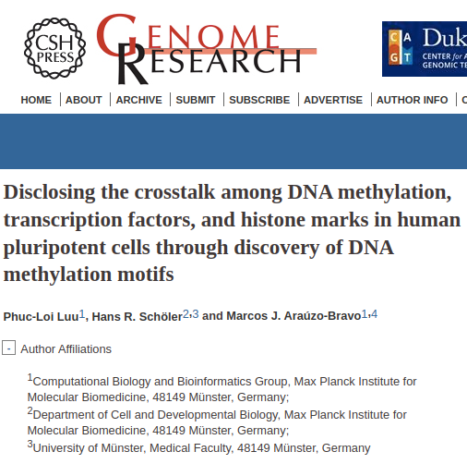
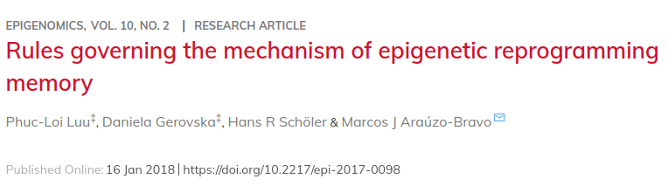
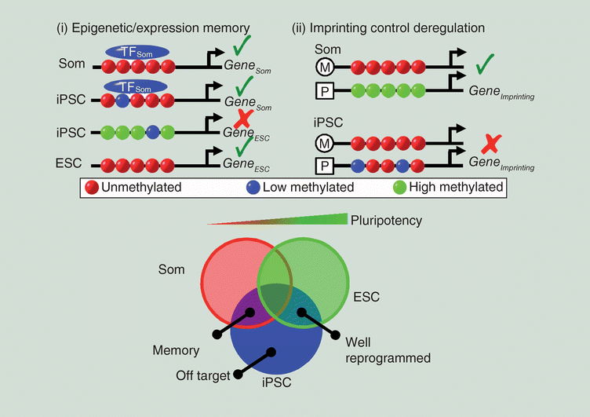
PhD in Bioinformatics and iPS technology
Research:
The dynamics of stem cell and induced pluripotent stem cell (iPS) epigenomes using genome-wide Next Generation Sequencing (NGS)
Somatic memory in iPS technology
Bioinformatics pipeline development

Slide 13
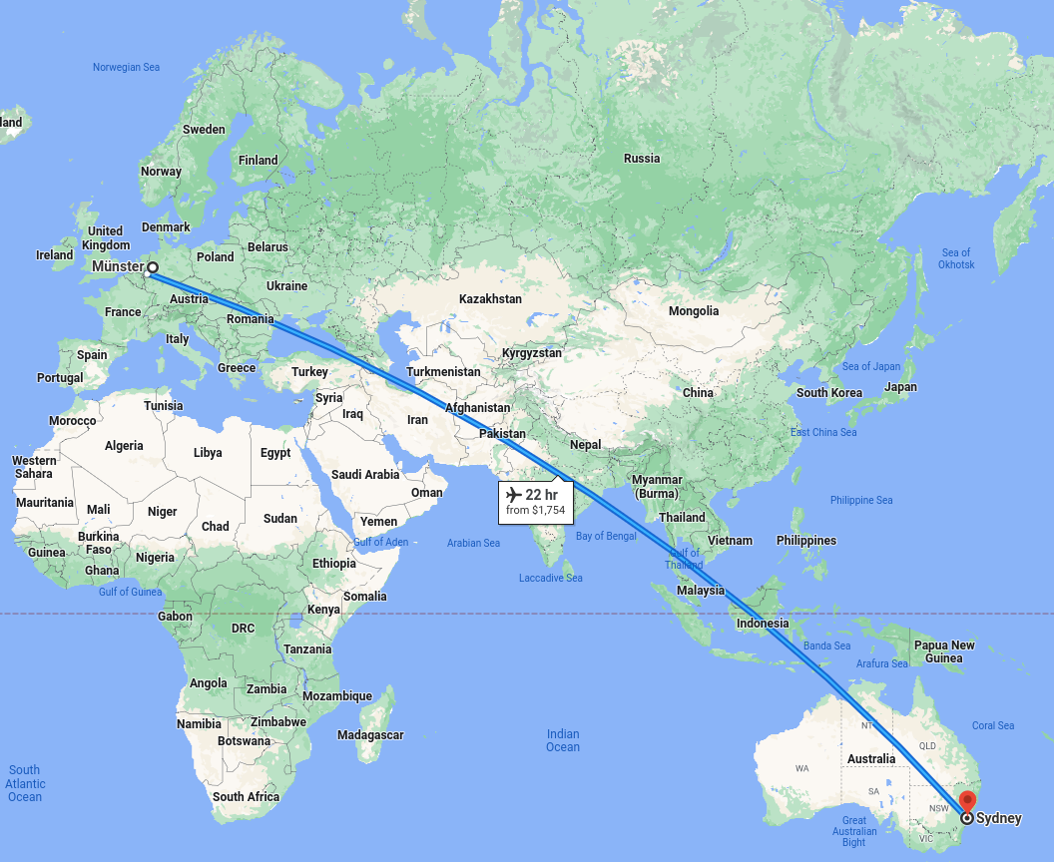
Seven years of research at Garvan Institute of Medical Research in Australia (2014 - 2022)

Slide 14
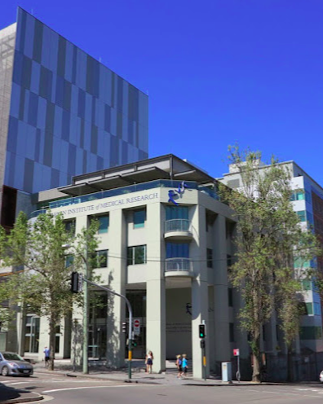

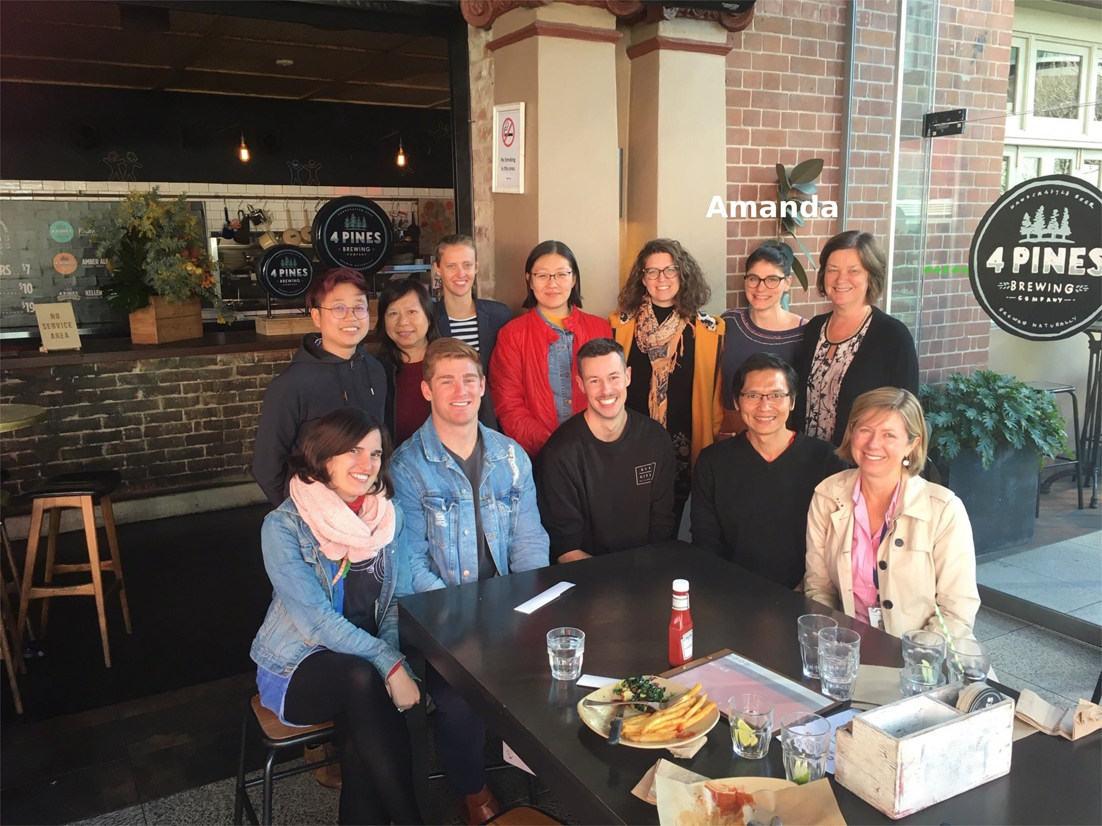

Seven years of research at Garvan Institute of Medical Research in Australia (2014-2022)
Major: Bioinformatics and Machine Learning
Research:
Cancer Genomics and Epigenomics
Single cell and Spatial transcriptomics technology and other diagnosis methods
Bioinformatics pipeline development

Slide 15
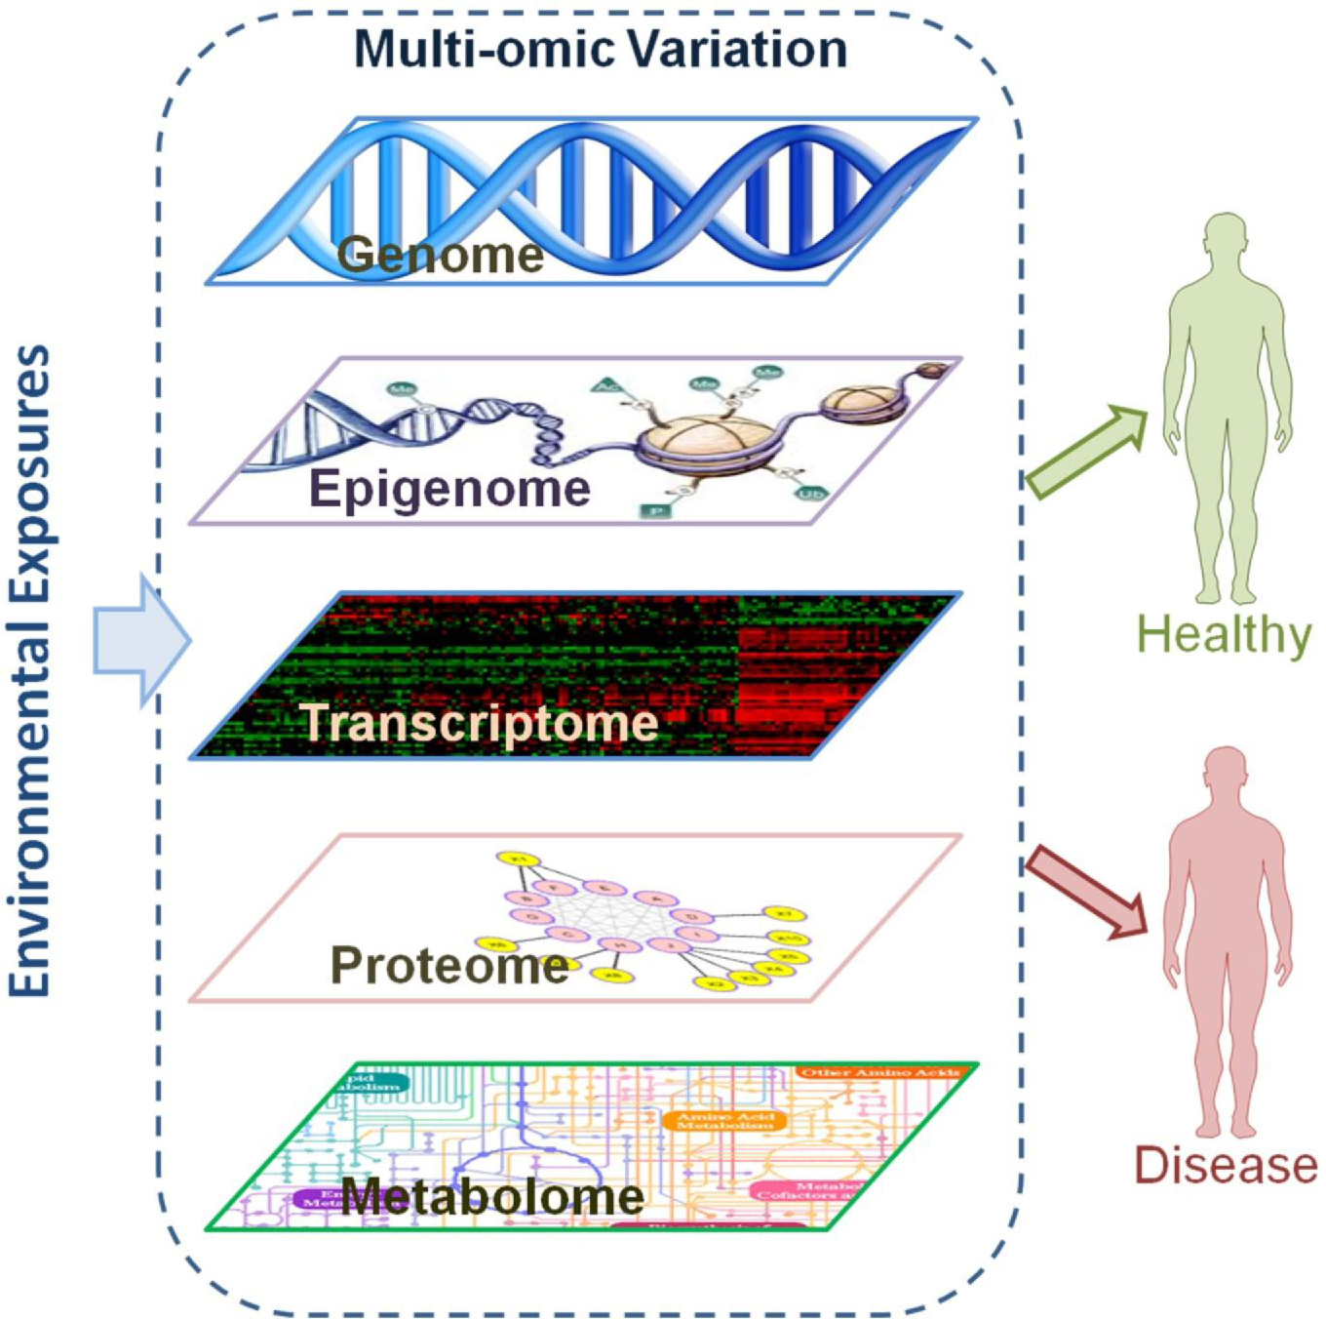
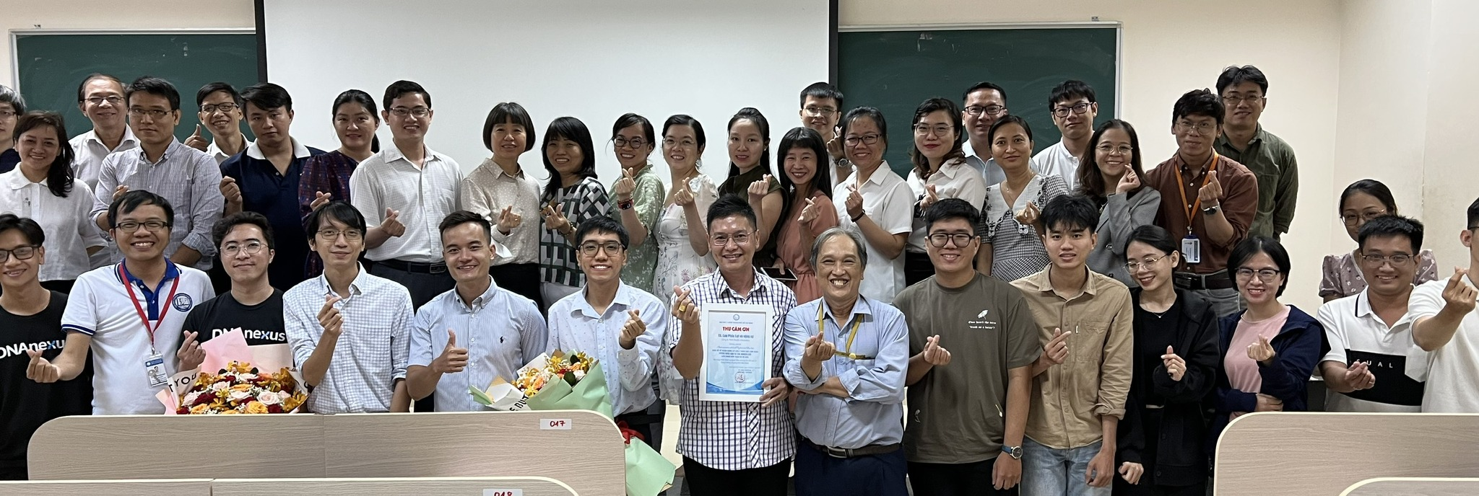
More than one year at Zymo Research (Sep 2022-Nov 2023)
Microbiomics
Epigenomics
Transcriptomics
Proteomics
Metabolomics
Bioinformatics

Slide 16
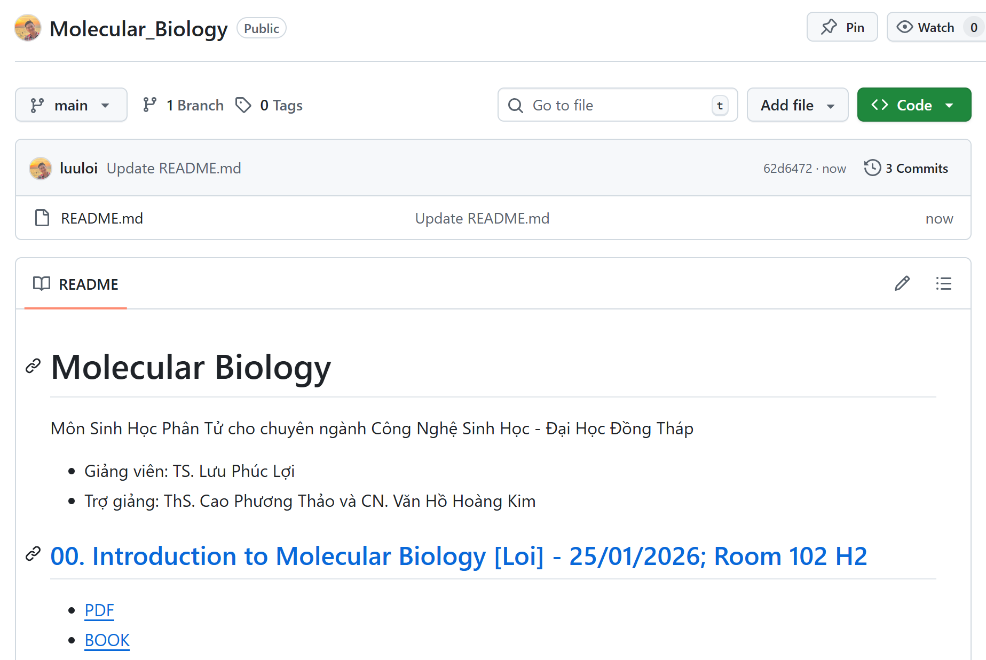
Curriculum of Introduction to Molecular Biology
https://github.com/luuloi/Molecular_Biology/

Slide 17
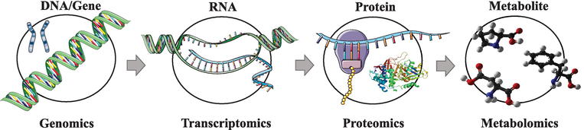
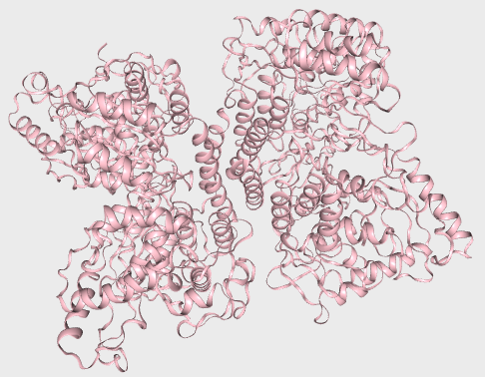
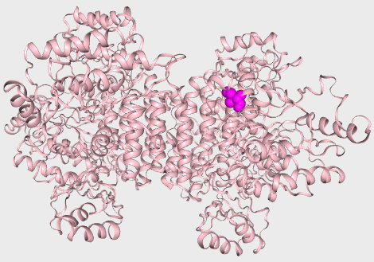
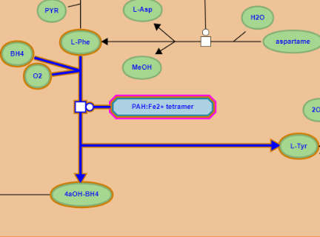
Central Dogma: Gene Mutation and Diseases
PAH gene
Ref …ATCGAT…
P1 …AACGAT…
NM_000277.3(PAH):c.971T>A
PAH mRNA
Ref …AUCGAU…
P1 …AACGAU…
NM_000277.3(PAH):c.971T>A
PAH protein
Ref …Ile-Asp…
P1 …Asn-Asp…
NM_000277.3(PAH):p.Ile324Asn
PAH
Ref Phe → Tyr
PAH
P1 Phe → Tyr
10.5772/intechopen.71769

Slide 18
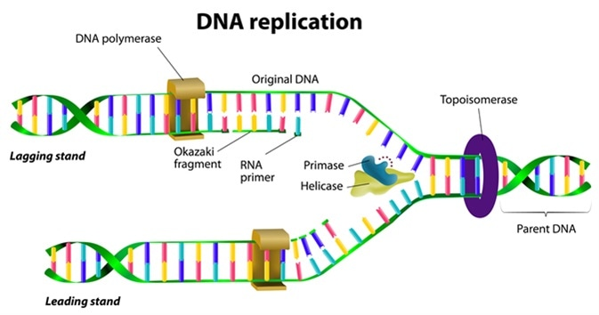
Content of Introduction to Molecular Biology
Part 1: DNA Replication and Repair
Part 2: Transcription and Transposition
Part 3: RNA Processing and Translation
Part 4: Molecular Techniques

Slide 19
Projects for Mid-Term and important dates
No | Project | Aim | Requirement | Group
1
2
3
4
5
6

Slide 20
Evalutation for the course
Presentation date (Mid-term exam): ?
Max 3 min each group (3 students)
1 to 2 questions each student
Mid-term score = Report (50%) + Presentation (40%) + Slide (10%)
Final exam:?
Final exam score = Quizzes (40%) + Final Test (60%)

Slide 21
No attendance checking
Nghỉ học được không bạn?
Được nhe!

Slide 22
No attendance checking
Nghỉ học được không bạn?
Nhưng khó đậu nhe!

Slide 23
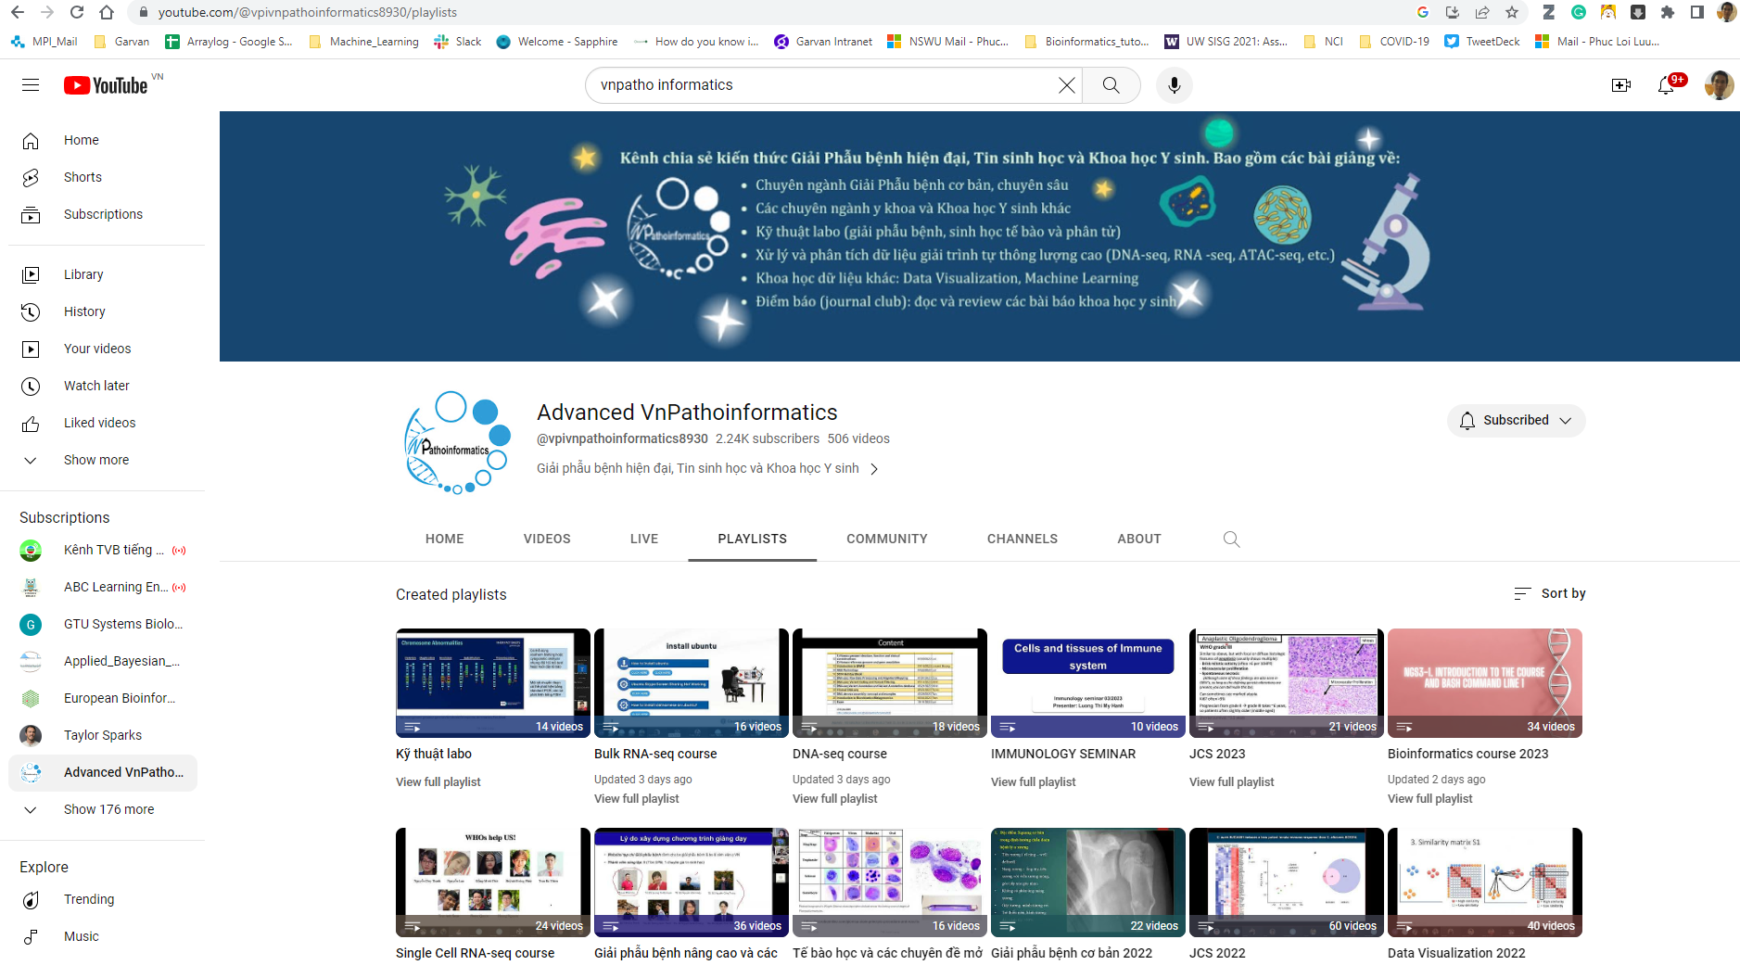
https://www.youtube.com/@vpivnpathoinformatics8930/playlists

Slide 24


